Slide 1

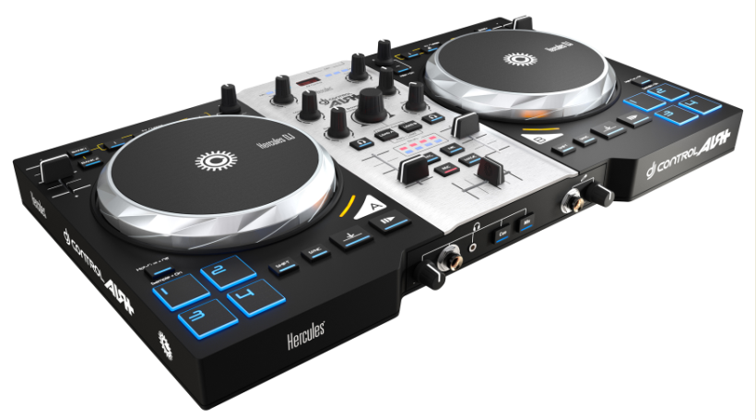
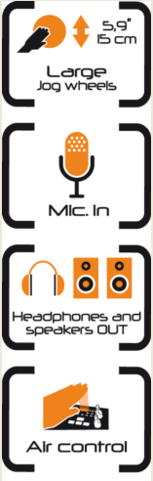
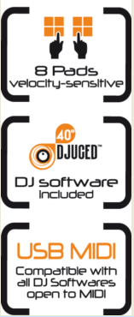


DJING / DJ CONTROL AIR+
Technical specifications
2-deck DJ controller with audio
Great jog wheels for scratching Pressure detection: as intuitive for scratching as turntables Large diameter: 5.9”/15 cm > 750 steps per rotation
Built-in audio Outputs Master: 2 x RCA (line) (ch. 1-2) 1 stereo ⅛” jack Monitor: 1 stereo ¼” jack (ch. 3-4) (headphones) 1 stereo ⅛” jack Microphone: input 1 x ¼” (balanced)
AIR sensor Long range sensor > 11.8”/30 cm Vu-meter for AIR sensor
Mechanical specifications
Enclosure 17.9 x 10.2” 45.5 x 26 cm
Jog wheels ø 5.9”/15 cm
Weight 4.4 lbs./2 kg
Minimum requirements
Computer CPU: 1.6 GHz or faster Intel Core™ 2 Duo or AMD 64-bit 2 GB of RAM or more High-speed USB port (USB 2 or 3) 100 MB available disk space CD/DVD-ROM drive Internet access Headphones + active speakers
Operating system (32/64-bit) MS Windows® Vista/7/8 or Mac OS® 10.7/10.8/10.9
Box contents
Hercules DJ CONTROL AIR+ S Series USB cable CD with DJUCED 40°(PC/Mac) Printed + PDF installation guide
Packaging specifications
Color box 20.4 x 12.3 x 4.1” 52 x 31.2 x 10.5 cm
Units / carton 2
Pallet 70
A new design for the Xtra Large 2-deck DJ controller
Large jog wheels for a better DJing experience
Size similar to jog wheels on DJ CD players:
5.9”/15 cm diameter at the base
5.1”/13 cm diameter on top
Mechanical pressure detection for intuitive scratching
Over 750 steps per rotation: precise position scanning
Add fun to your mix with the AIR control
The contactless sensor lets you control the mix from above, without even touching the device, with 1 ft/30 cm of range
DJ CONTROL AIR+ converts the vertical distance to your hand into a MIDI command
Velocity pads to express your creativity
4 velocity pads on each deck let you liven up your mixes
Instantly trigger sample playback or hot cues with one touch
The harder the pads are tapped, the louder the volume of the samples played
Ergonomic design
Comfortable size: 17.7”/45 cm wide for plenty of space between controls while performing
Soft rubber cladding on rotary caps and transport buttons for easier handling: fingers won’t slip
Versatile microphone input
High audio quality for balanced and unbalanced dynamic microphones
2 operating modes to integrate vocals into your mix:
Direct pass-through: speak over the music
Software processing: record your voice or add real-time effects to your voice
Reference number / Barcode
International: 4780774/ 3362934744526
USA: 4780774/ 66329641970 5
Hercules® is a registered trademark of Guillemot Corporation S.A. Microsoft® Windows® XP, Vista , 7 and 8 are registered trademarks of Microsoft Corporation in the United States and/or other countries. Intel® Core™ are trademarks of Intel Corporation. Apple®, the Apple logo and Mac OS® are registered trademarks of Apple Computer, Inc. All other trademarks and brand names are hereby acknowledged and are property of their respective owners. Illustrations not binding.

Slide 2
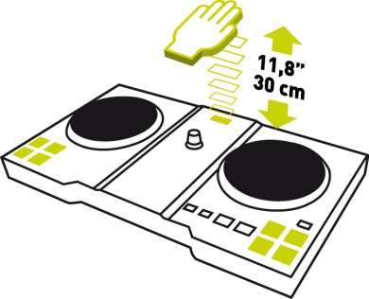
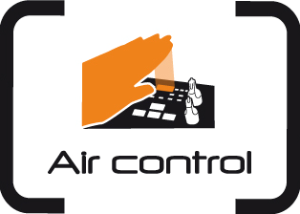
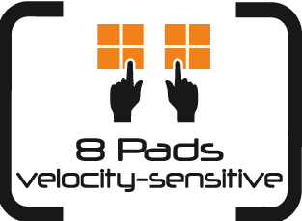
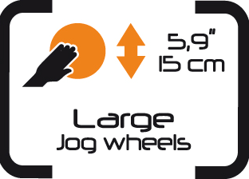
DJING / DJ CONTROL AIR+
AIR control
Why is the controller called DJ CONTROL AIR+ S Series?
“AIR” stands for Adjustment by InfraRed: it is a contactless control.
The DJ places his or her hand flat over the infrared beam.
The controller calculates the distance between the sensor and the hand, and converts it into a gradual MIDI command.
This MIDI command modulates a setting in the DJ software.
Does the AIR control require specific lighting conditions?
No: the AIR control functions under any lighting conditions.
The infrared light beam projected toward the hand is invisible.
The sensor captures the infrared reflection on the hand, and uses the reflection to calculate the hand’s distance.
The reflection is the same in both daylight and low-light conditions, allowing the AIR control to be used during the day, at night or in places with weak lighting.
The AIR control functions with all flesh tones. The only incompatibility is the use of black gloves (as the infrared sensor would not be able to detect the reflection).
8 pads
2 sets of 4 pads control hot cues and samples.
The DJ taps on the pads with his or her fingertips to send commands such as cue points or samples.
The pads light up when touched.
In addition to a binary On/Off command, each pad can transfer velocity information to modulate the command.
For example: in sampler mode, the velocity can control the volume of a sample’s playback. The playback volume depends on how soft or how hard the DJ taps on the pad.
Pressure-detecting jog wheels
The jog wheels detect the pressure from the user’s hand.
With scratch mode enabled (“Vinyl” button to switch on/off), the jog wheels scratch when the hand’s weight is detected, and stop scratching when the hand’s weight is no longer detected. This allows the DJ to:
stop playback by pressing on the jog wheel.
restart playback by lifting up his or her hand.
scratch by turning the jog wheel while pressing down, and stop scratching by lifting up his or her hand.
bend the pitch (if playback is on) / browse within tracks (if playback is off) by turning the jog wheels using their outer ring, to avoid applying downward pressure.
With scratch mode disabled, the jog wheels bend the pitch or browse within tracks when turned, regardless of the pressure applied.
Reference number / Barcode
International: 4780774/ 3362934744526
USA: 4780774/ 66329641970 5
Hercules® is a registered trademark of Guillemot Corporation S.A. Microsoft® Windows® XP, Vista, 7 and 8 are registered trademarks of Microsoft Corporation in the United States and/or other countries. Intel® Core™ are trademarks of Intel Corporation. Apple®, the Apple logo and Mac OS® are registered trademarks of Apple Computer, Inc. All other trademarks and brand names are hereby acknowledged and are property of their respective owners. Illustrations not binding.

Slide 3
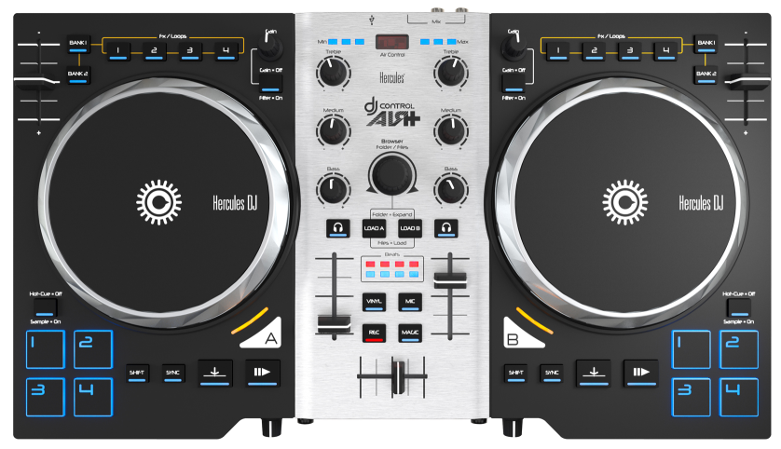
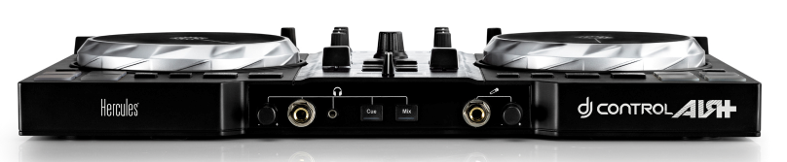
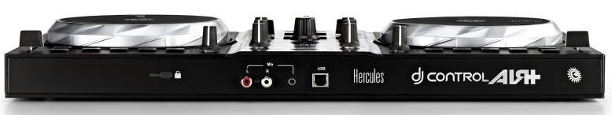
DJING / DJ CONTROL AIR+
Top view
Front view
Back view
Reference number / Barcode
International: 4780774/ 3362934744526
USA: 4780774/ 66329641970 5
Hercules® is a registered trademark of Guillemot Corporation S.A. Microsoft® Windows® XP, Vista, 7 and 8 are registered trademarks of Microsoft Corporation in the United States and/or other countries. Intel® Core™ are trademarks of Intel Corporation. Apple®, the Apple logo and Mac OS® are registered trademarks of Apple Computer, Inc. All other trademarks and brand names are hereby acknowledged and are property of their respective owners. Illustrations not binding.

